Slide 1
Data Structures Basics
AI2C Tech Intro

Slide 2
Objectives
Know when and how to apply nested lists
Implement and discuss some basic list manipulation techniques

Slide 3
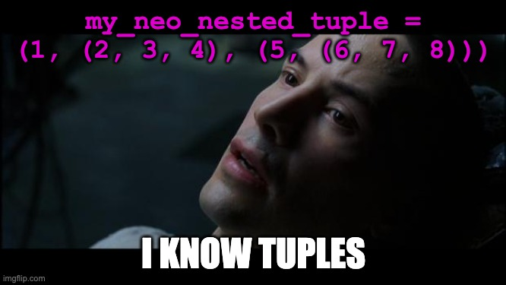
Python review

Slide 4
Mutable vs Immutable

Slide 5
Hands-On #1
Mutable and immutable structures
Working with tuples and lists

Slide 6
Nested lists

Slide 7
Hands-On #2
Work with nested lists to represent arrays

Slide 8
Questions?

